Slide 1

HAPTIC
RETARGETING
GRUPPO 9
Dario Doronzo, Davide Trenti,
Fabiola Polidoro, Giovanni Forcelli

Slide 2




PROJECT BY
Mahdi Azmandian, Mark Hancock, Hrvoje Benko, Eyal Ofek, Andrew D. Wilson

Slide 3
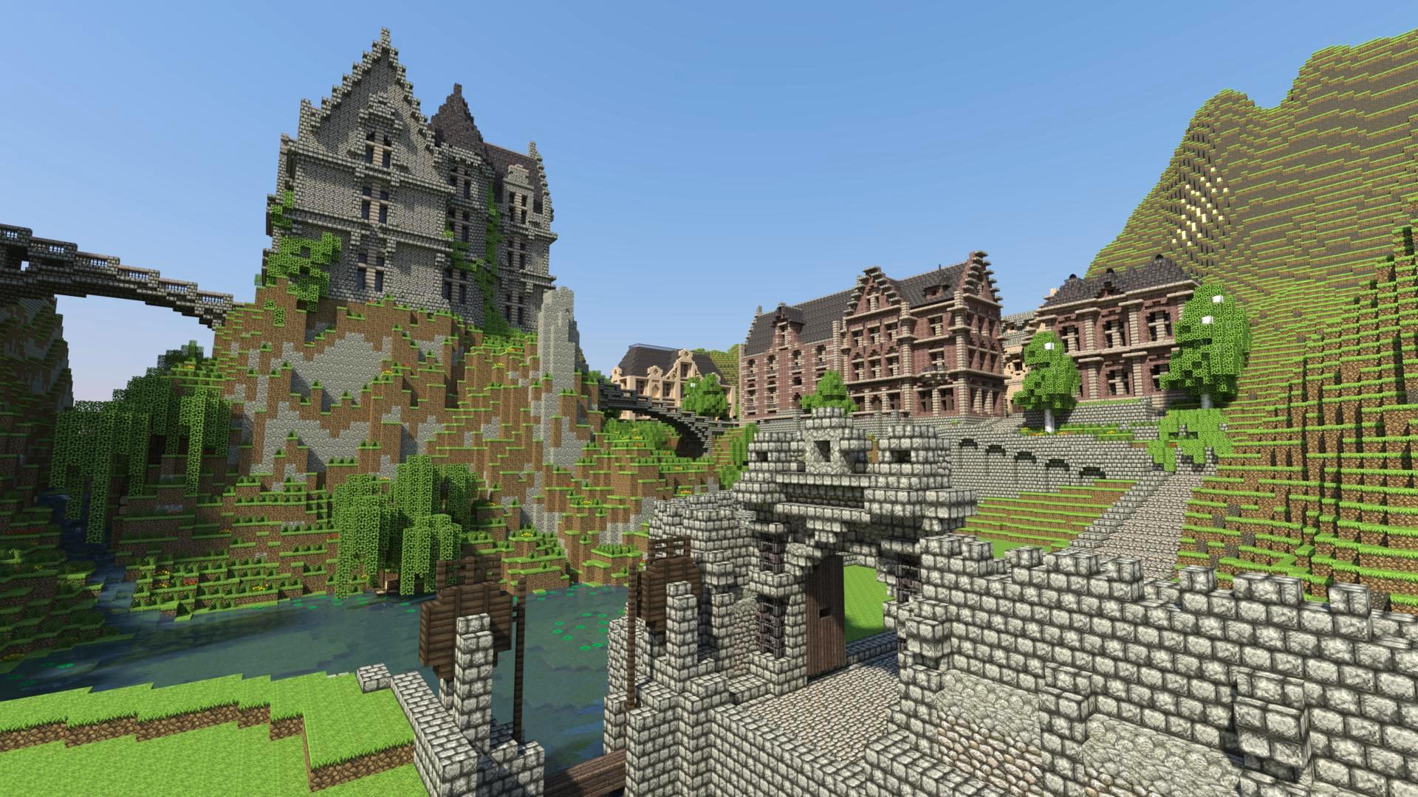
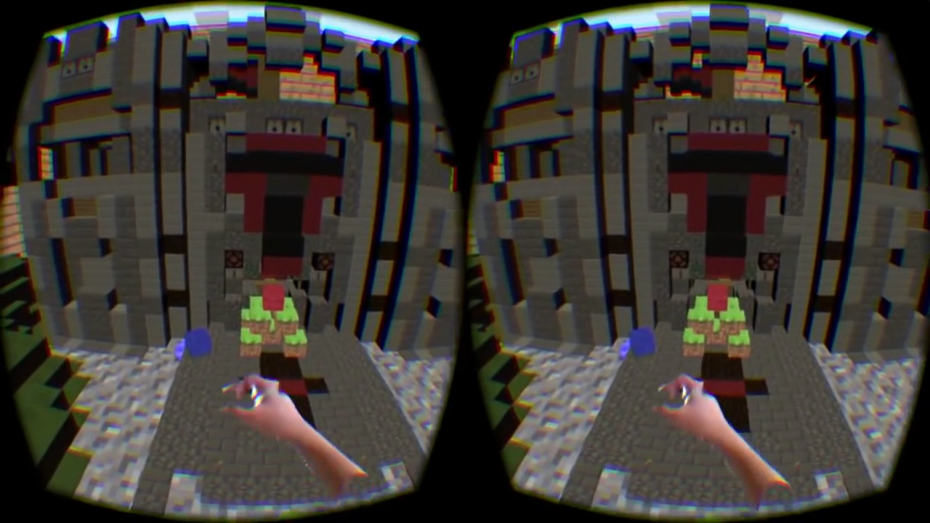
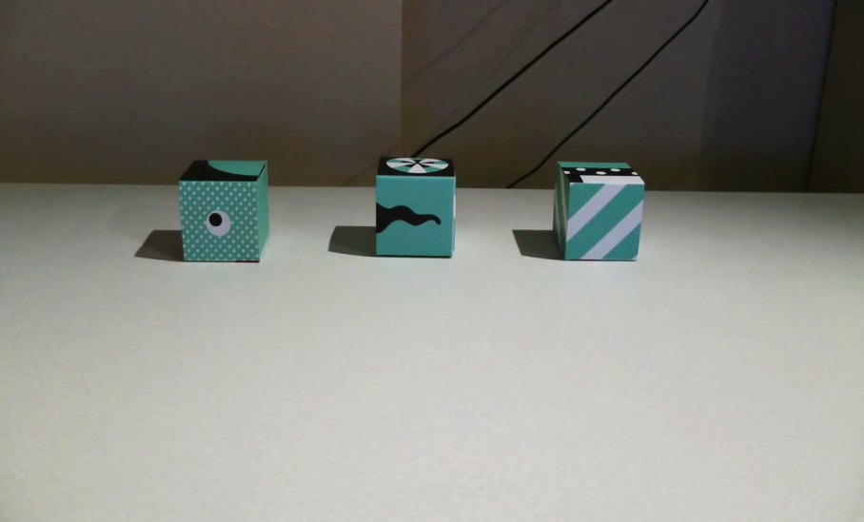
minecraft

Slide 4
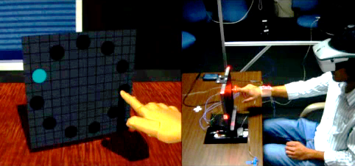
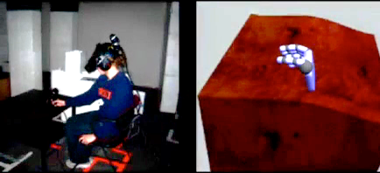
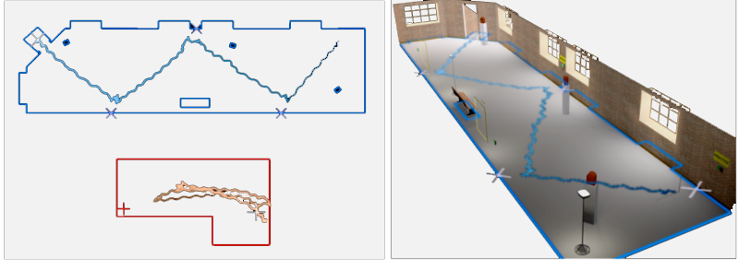
Related works
REDIRECTED TOUCHING
REDIRECTED WALKING

Slide 5
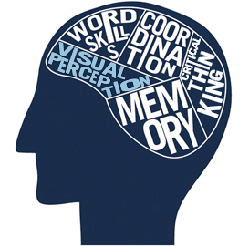
VISUAL PERCEPTION
When senses conflict
vision often dominates
In particular:
Proprioception
Vestibular cues
These values can be scaled by:
Traslation: +26% -14%
Rotation: +49% -20%
And the user won’t notice

Slide 6
GOALS
Repurpose the passive haptics of the same real physical objects across multiple virtual objects…
…by finding a mapping between real and virtual coordinates.
Requirements:
The mapping is dynamic
The mapping is transparent

Slide 7
techniques
BODY WARPING
WORLD WARPING
HYBRID WARPING

Slide 8
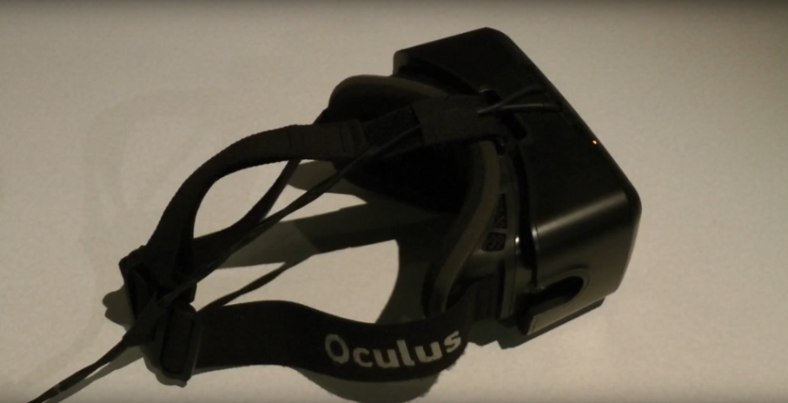
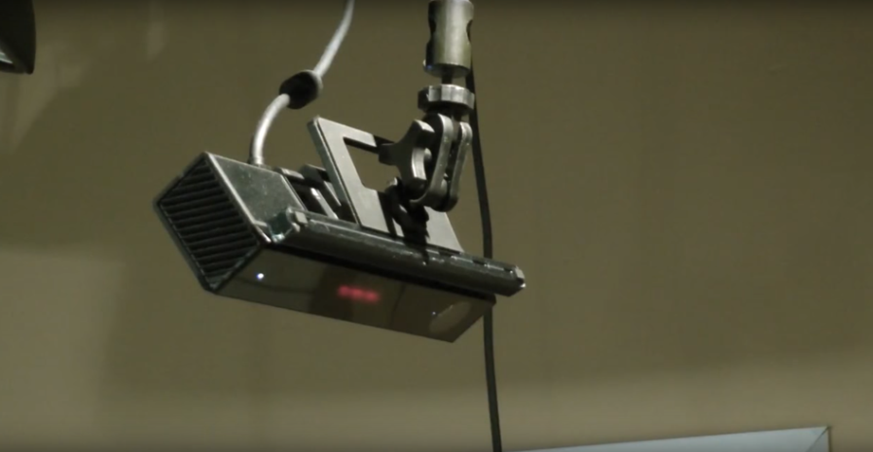
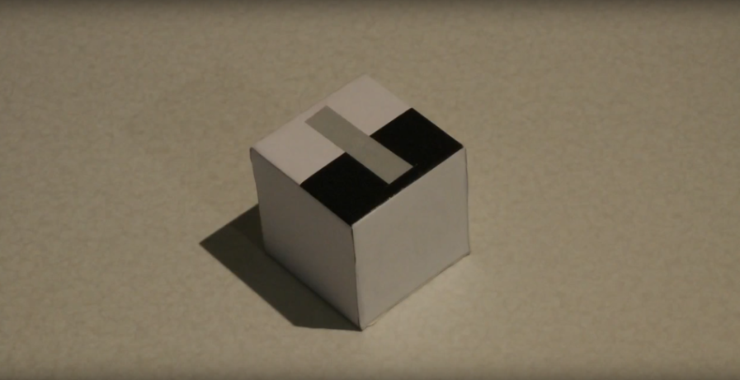
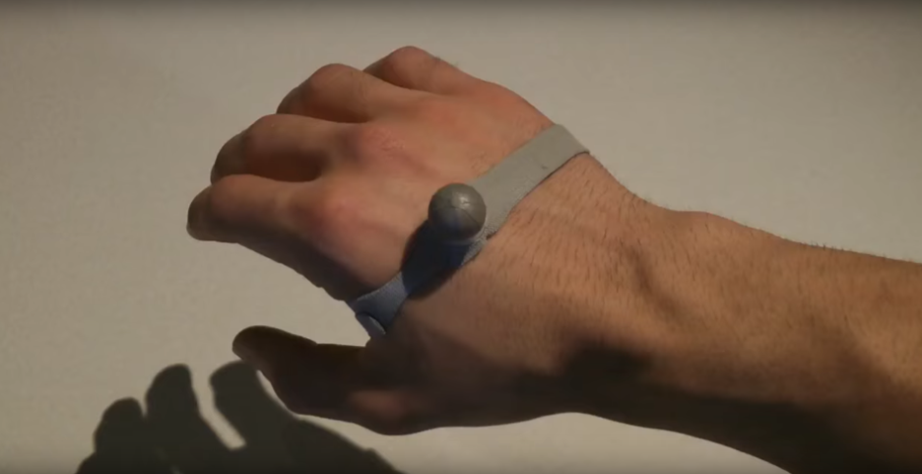
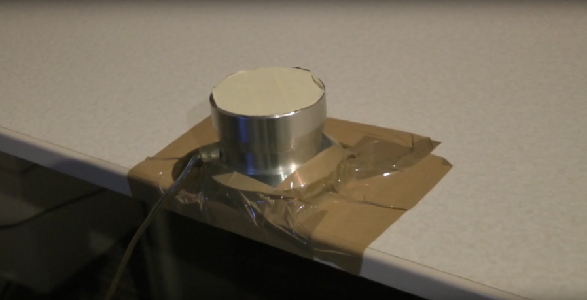
implementation
Oculus Rift dk2
Kinect
Tracked cube
Hand marker
Physic button

Slide 9
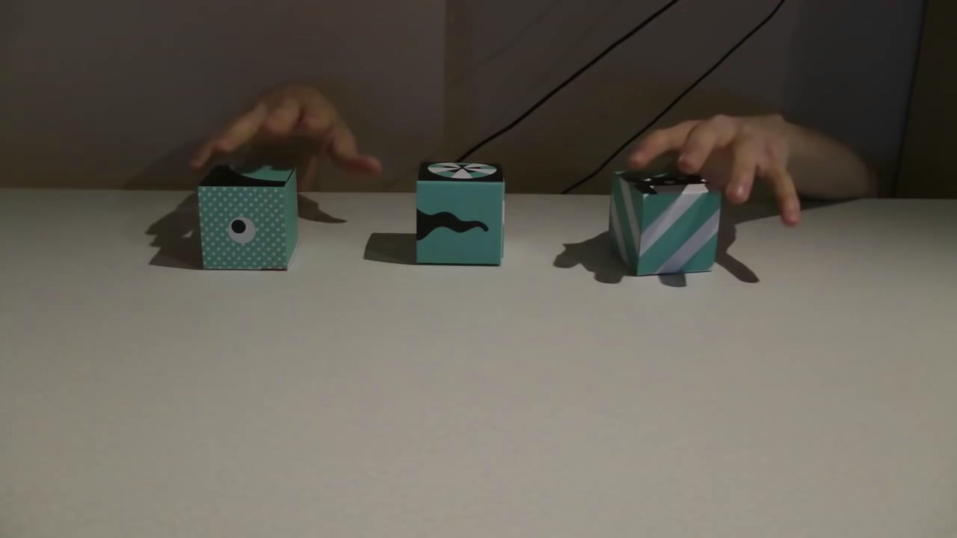
BODY WARPING

Slide 10
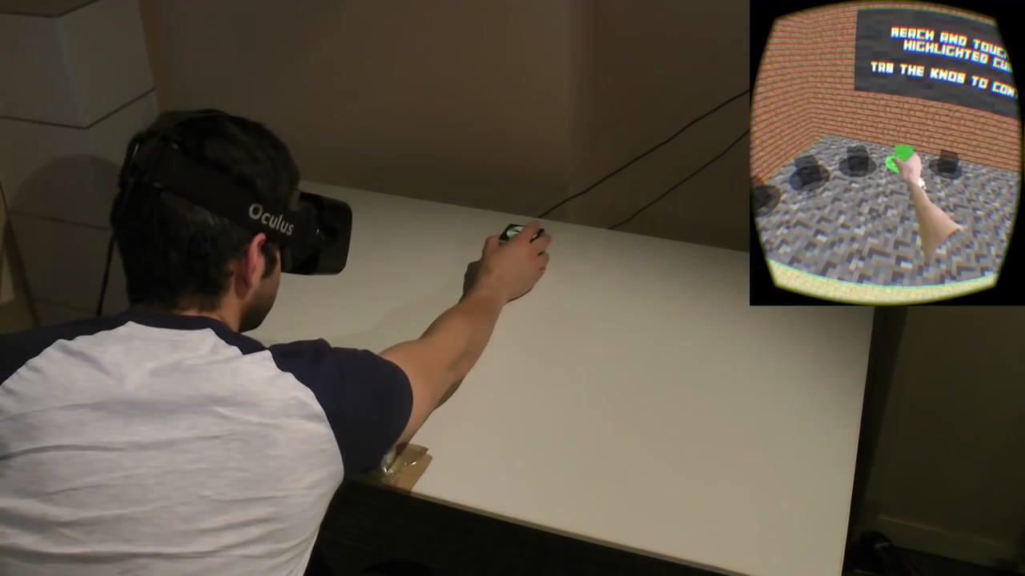
WORLD WARPING

Slide 11
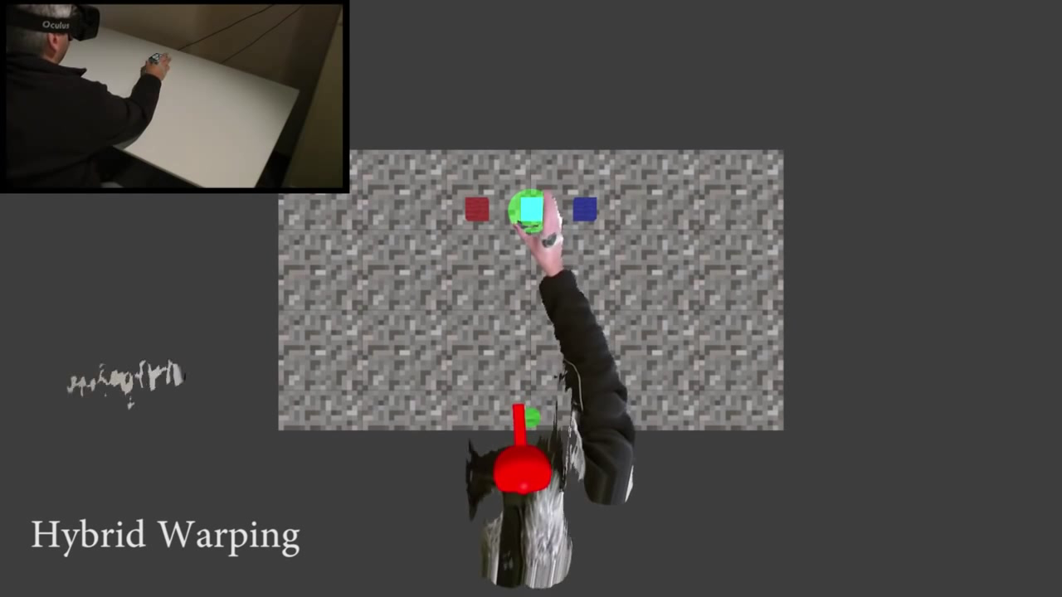
HYBRID WARPING

Slide 12
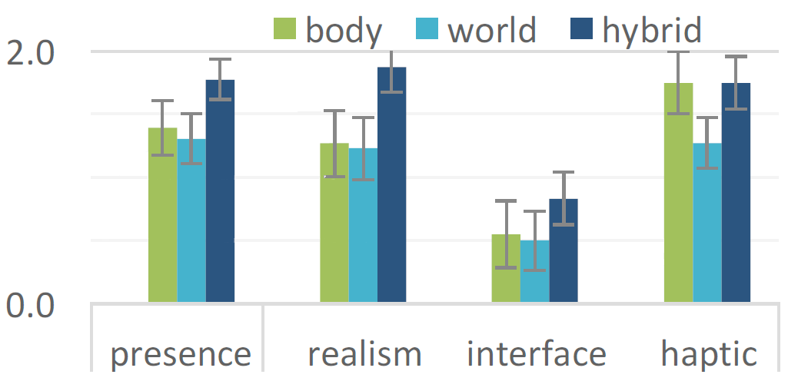
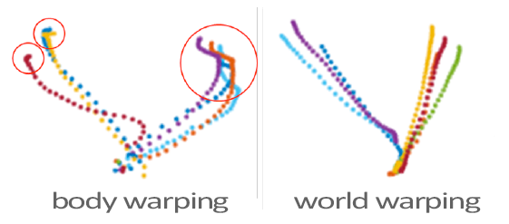
RESULTS
Precence analysis
Hand path
BODY WARPING | WORLD WARPING
Always works Better to use slow movements | No corrections Requires head movements

Slide 13
Future work
Investigate detection thresholds
Path prediction
Shape mapping
Advanced warping (eg. mesh deformation)

Slide 14
Thank you!
Questions?

